Slide 1
Intelligent System for Breast Tumor Diagnosis Based on Clinical Features
Students Names:
Rama Zraiqat 2019978110
Ahlam bani Abdoh 2017977002
Manal Toubat 2020978146

Slide 2
Problem Statement & Motivation
🎯 Objective
Develop an accurate machine learning model to classify breast cancer tumors as benign or malignant based on cellular characteristics.
📊 Why This Matters
Breast cancer is one of the most common cancers affecting women worldwide
Early detection significantly improves survival rates
Machine learning can assist medical professionals in diagnosis
Automated classification can reduce diagnostic time and human error

Slide 3
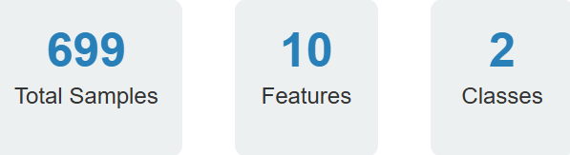
Dataset Overview
📋 Dataset Source
Wisconsin Breast Cancer Database - containing cellular measurements from fine needle aspirate (FNA) of breast masses.
🔍 Target Classes
Benign (Class 2): Non-cancerous tumors
Malignant (Class 4): Cancerous tumors

Slide 4
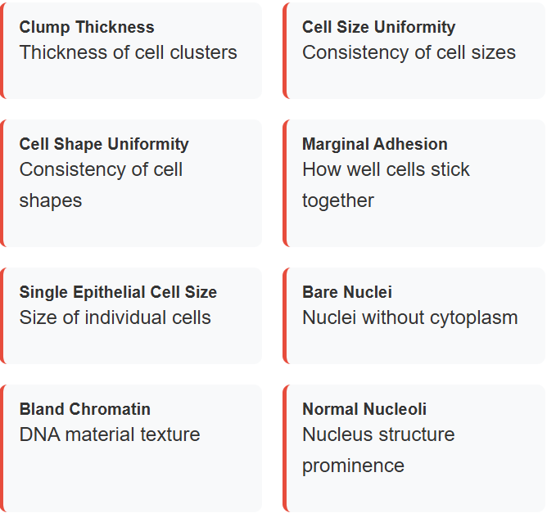
Feature Description Each feature is scored on a scale of 1-10, where higher values generally indicate higher malignancy risk.

Slide 5
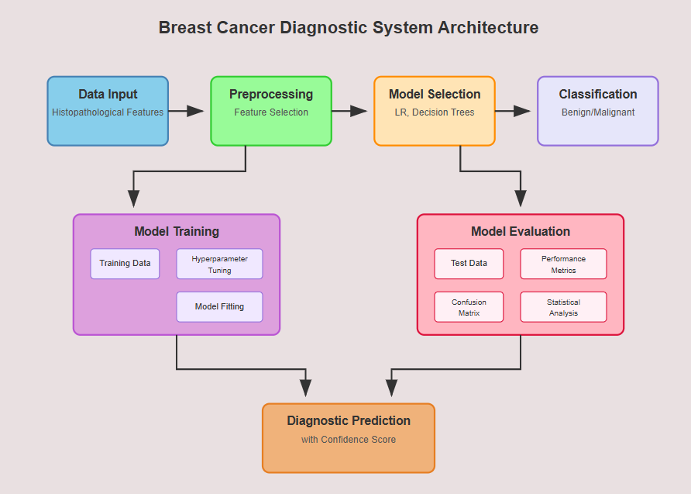

Slide 6
🛠️ Implementation
Environment: Google Colab with Python
Libraries Used: pandas, numpy, matplotlib, seaborn, scikit-learn
Workflow:
Data loading and cleaning
Exploratory Data Analysis (EDA)
Feature selection and correlation handling
Train-test split (80:20)
Model training: Logistic Regression, XGboost, Decision Tree
Performance evaluation using accuracy, precision, recall, F1-score

Slide 7
⚠️ Challenges and Limitations
Missing Data: ‘BareNuc’ column contained missing entries (‘?’), requiring imputation
Imbalanced Dataset: Minor class imbalance slightly affected performance; SMOTE or similar techniques were not applied
Multicollinearity: High correlation between UnifSize and UnifShape—needed dimensionality reduction
Limited Feature Set: Only 10 predictive features; richer datasets may improve performance
Scalability: Models trained on a small dataset (699 samples)—generalizability to larger clinical datasets needs further validation

Slide 8
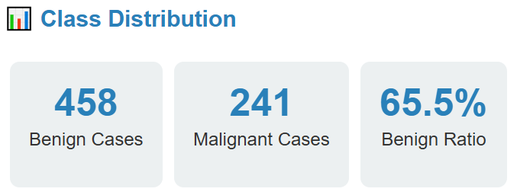
Exploratory Data Analysis
🔍 Key Findings
Dataset Shape: 699 samples × 11 features (including ID)
Missing Values: Found in 'BareNuc' column (marked as '?')
Data Types: Mixed numeric and object types requiring conversion

Slide 9
Data Preprocessing
🎯 1. Missing Value Treatment
Identified '?' values in 'BareNuc' column
Converted to numeric format using pd.to_numeric()
Imputed missing values with median (value = 1)
🎯 2. Feature Selection
Removed 'ID' column (no predictive value)
Dropped 'UnifShape' due to high correlation with 'UnifSize' (r > 0.9)
Addressed multicollinearity issues

Slide 10
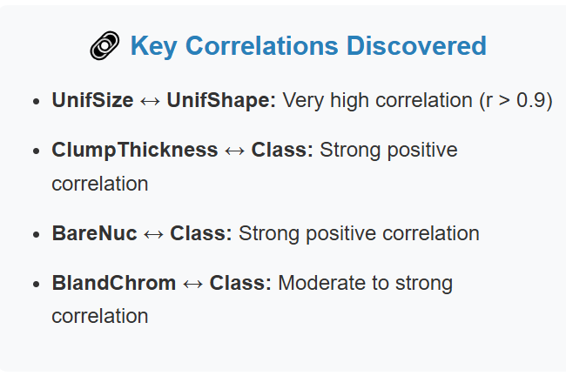
Correlation Analysis
🎯 Impact on Model
Multicollinearity Issue: UnifSize and UnifShape were highly correlated
Solution: Removed UnifShape to prevent model instability
Feature Importance: Several features show strong correlation with target class

Slide 11
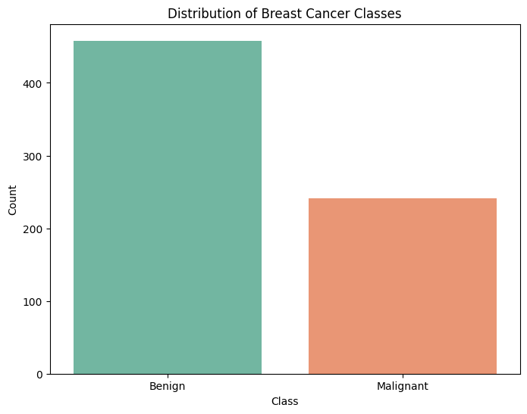
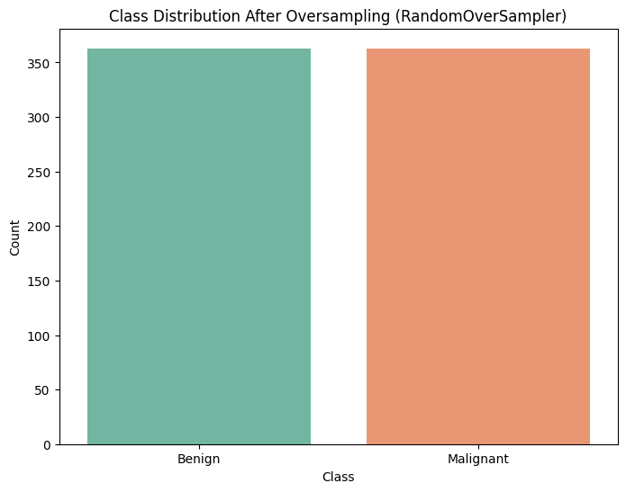
Imbalance Classes Distribution

Slide 12
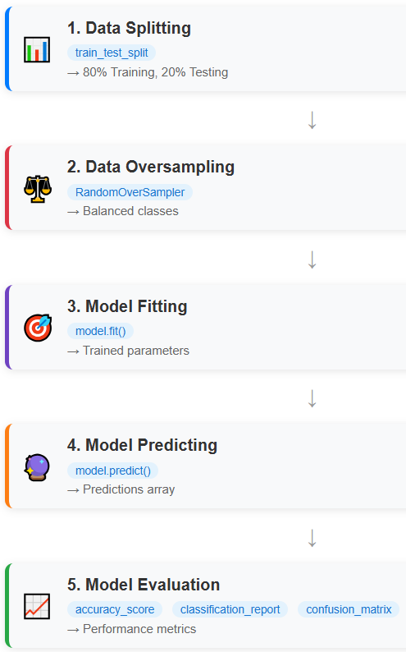
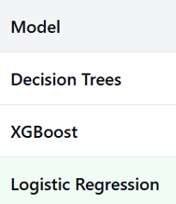
Model Training & Evaluation Process

Slide 13
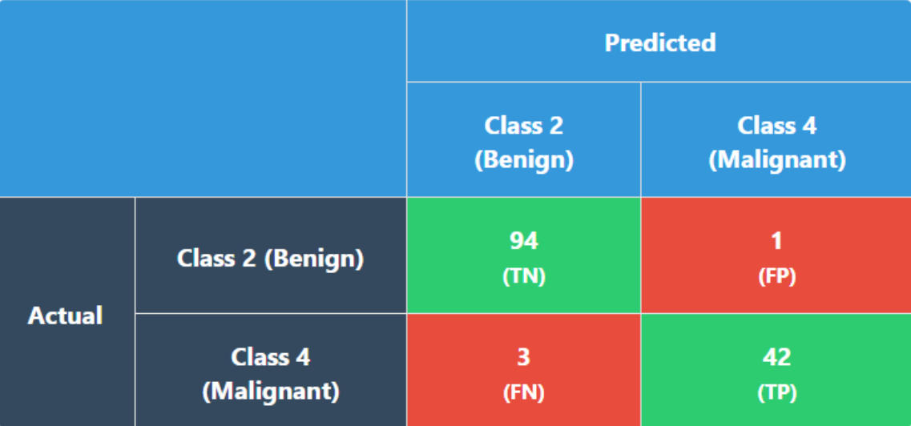
Confusion Matrix

Slide 14
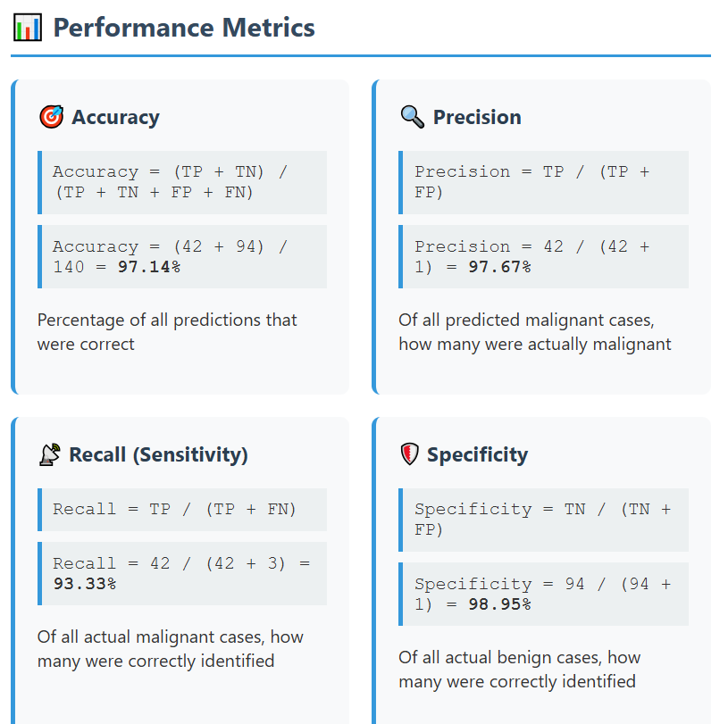
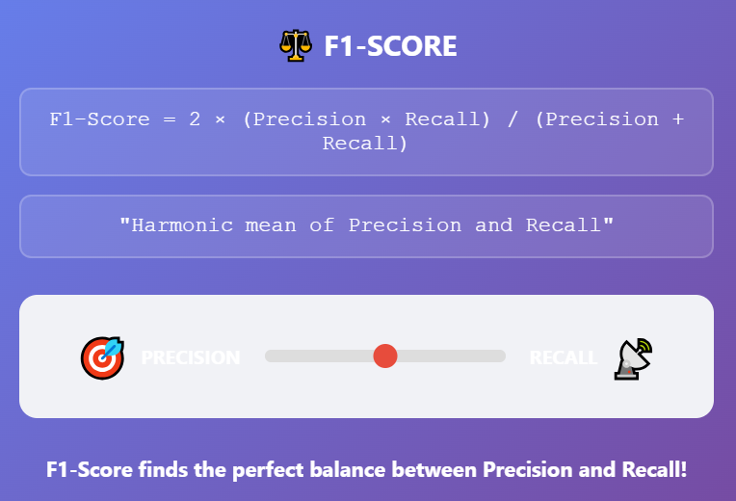

Slide 15
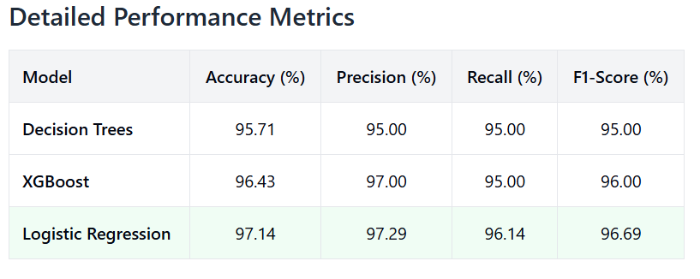
Models Performance Results

Slide 16
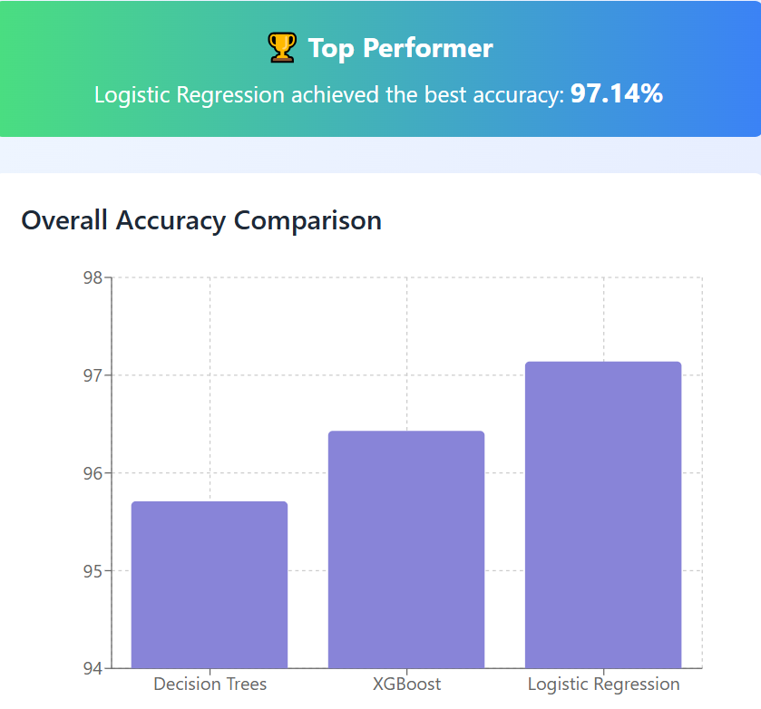
Models Performance Results

Slide 17
🔮 Future Work
Model Optimization:
Explore more models methods (Random Forest, Neural Network)
Class Imbalance Handling:
Apply different oversampling techniques such as SMOTE
Advanced Models:
Incorporate Deep Learning models (e.g., ANN)
Model Deployment:
Build a web-based diagnostic tool for clinicians
Larger Dataset Integration:
Validate model on real-world, multi-center datasets

Slide 18
✅ Conclusion
Developed a machine learning pipeline to classify breast cancer as benign or malignant with solid performance across models
Successfully handled data cleaning, preprocessing, and feature selection
Logistic Regression model achieved promising accuracy
Study highlights the potential of AI in supporting early breast cancer diagnosis
Future enhancements can further improve model accuracy and clinical usability

